Slide 1
Pointers

Slide 2
Variable
A variable is a named memory location.
Variables provide direct access to its memory location.
A variable has a name, an address, a type,and a value:
"the name identifies the variable to the programmer
"the address specifies where in main memory the variable is located

Slide 3
What is a variable?
"the type specifies how to interpret the data stored in main memory and how long the variable is
"the value is the actual data stored in the variable after if has been interpreted according to a given type

Slide 4
Pointer variable
A pointer is a variable that contains the memory location of another variable.
Syntax:-
type * variable name
You start by specifying the type of data stored in the location identified by the pointer.
The asterisk tells the compiler that you are creating a pointer variable.
Finally you give the name of the variable.

Slide 5
Declaring a Pointer Variable
To declare ptr as an integer pointer:
  int *ptr;
To declare ptr as a character pointer:
  char *ptr;

Slide 6
Address operator:
Once we declare a pointer variable we must point it to something we can do this by assigning to the pointer the address of the variable you want to point as in the following example:
ptr=&num;
This places the address where num is stores into the variable ptr. If num is stored in memory 21260 address then the variable ptr has the value 21260.

Slide 7
Address and Pointers
Memory can be conceptualized as a linear set of data locations.
Variables reference the contents of a locations
Pointers have a value of the address of a given location
ADDR1
Contents1
ADDR2
ADDR3
ADDR4
ADDR5
ADDR6
*
*
*
ADDR11
Contents11
*
*
ADDR16
Contents16
Lect 14 P. <number>
Notes:
Engineering H192
Winter 2005
Lecture 14
Instructor:
A computer has two basic types of busses to the memory: an address and data bus. Thus far we have been concerned mainly with the data we store but not its storage location. Pointers allow us to also use the address in which our data is stored in various ways. This conceptualization of memory can be likened to a street with various address where mail is delivered. The mailman delivers the correct data (letters) to the correct address written on each piece of mail.

Slide 8
Pointer Variable
Assume ptr is a pointer variable and x is an integer variable
x
10
ptr
&x
Now ptr can access the value of x.
HOW!!!!
Write: *variable . For example:
Cout<< *ptr;
x = 10
ptr = &x

Slide 9
Variables, Addresses and Pointers
main()
{
int a = 5;
int b = 6;
int *c;
// c points to a
c = &a;
}
Memory Value
a (1001) 5
b (1003) 6
c (1005) 1001

Slide 10
include< stdio.h >
{
int num, *intptr;
float x, *floptr;
char ch, *cptr;
num=123;
x=12.34;
ch=’a’;
intptr=&num;
cptr=&ch;
floptr=&x;
cout<<“Num “<<*intptr,<<“ stored at address “<<intptr;
cout<<“Value “<<*floptr <<“ stored at address “<<floptr;
cout<<“Character <<*cptr <<“stored at address”<<cptr;
}

Slide 11
Run this code
int main()
{
int x;
int *ptr;
x = 10;
ptr = &x;
*ptr = *ptr + 1;
cout<< x;
return 0;
}

Slide 12
Manipulating Pointer Variable
Once a variable is declared, we can get its address by preceding its name with the unary & operator, as in &k.
We can "dereference" a pointer, i.e. refer to the value of that which it points to, by using the unary '*' operator as in *ptr

Slide 13
Reference
Reference &
Retrieve the memory address of a variable
int a = 6;
int* c = &a; // &a is the memory location of variable a

Slide 14
Dereference
Dereference * Accessing the variable (content) the pointer points to
(Indirection)
int a = 6;
int* c = &a;
*c = 7; /* Changes content of variable a by using its address stored in pointer c */
equivalent to
a = 7;

Slide 15
Constant Pointers
A constant pointer, ptr, is a pointer that is initialized with an address, and cannot point to anything else.
We can use ptr to change the contents of value
Example
int value = 22;
int * const ptr = &value;
CIS 15 Pointer Arithmetic

Slide 16
Constant Pointer
Constant pointer means the pointer is constant. Constant pointer is NOT pointer to constant.
For eg:
int * const ptr2 indicates that ptr2 is a pointer which is constant. This means that ptr2 cannot be made to point to another integer.
However the integer pointed by ptr2 can be changed.

Slide 17
    //const pointer void
    main()
    {
    int i = 100,k;
    int* const pi = &i;
    *pi = 200;
    pi=&k; //won't compile
    }

Slide 18
Constant Pointers to Constants
A constant pointer to a constant is:
  a pointer that points to a constant
  a pointer that cannot point to anything except what it is pointing to
Example:
int value = 22;
const int * const ptr = &value;
CIS 15 Pointer Arithmetic

Slide 19
//const pointer to a const void
f3()
{
int i = 100;
const int* const pi = &i;
//*pi = 200; <- won't compile
//pi++; <- won't compile
}

Slide 20
Pointer to constant
Pointer to constant is
const int * ptr1 indicates that ptr1 is a pointer that points to a constant integer. The integer is constant and cannot be changed. However, the pointer ptr1 can be made to point to some other integer.

Slide 21
//pointer to a const
void f1()
{
int i = 100;
const int* pi = &i;
//*pi = 200; <- won't compile
pi++;
}m

Slide 22
Pointer arithmetic
Valid operations on pointers include:
- the sum of a pointer and an integer
- the difference of a pointer and an integer
- pointer comparison
the difference of two pointers.
Increment/decrement in pointers
assignment operator used in pointers

Slide 23
Example
void main()
{
int a=25,b=78,sum;
int *x,*y;
x=&a;
y=&b;
sum= *x + *y;
cout<<“Sum is : ”<<sum;
}

Slide 24
Assignment in pointers
Pointer variables can be "assigned":
int *p1, *p2;
p2 = p1;
  Assigns one pointer to another
  "Make p2 point to where p1 points"
Do not confuse with:
*p1 = *p2;
  Assigns "value pointed to" by p1, to "value
  pointed to" by p2

Slide 25
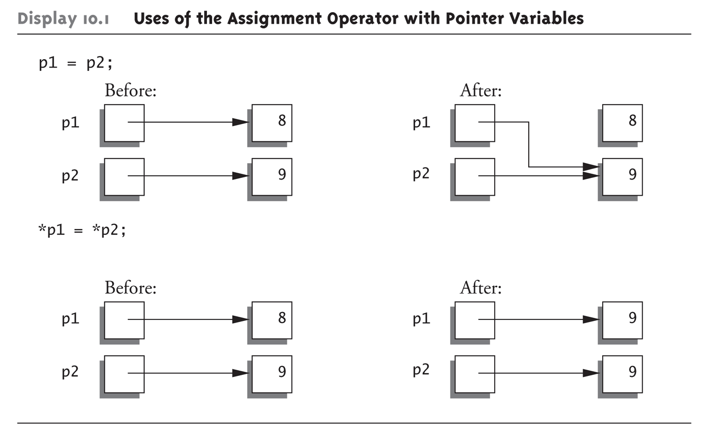
Diagrammatic representation

Slide 26
Comparison in pointers
Two pointers of the same type, p and q, may be compared as long
as both of them point to objects within a single memory block
• Pointers may be compared using the <, >, <=, >=, == , !=
• When you are comparing two pointers, you are comparing the
values of those pointers rather than the contents of memory locations pointed to by these pointers

Slide 27
Increment and decrement
Data Type | Initial address | Operation |  | Address after operation s |  | Required bytes
Int i=2 | 4046 | ++ | -- | 4048 | 4044 | 2bytes
Char c=‘x’ | 4053 | ++ | -- | 4054 | 4042 | 1bytes
Float f=2.2 | 4050 | ++ | -- | 4054 | 4046 | 4bytes
Long l=2 | 4060 | ++ | -- | 4064 | 4056 | 4bytes

Slide 28
You can perform a limited number of arithmetic operations on pointers. These operations are:
Increment and decrement
Addition and subtraction
Comparison
Assignment
The increment (++) operator increases the value of a pointer by the size of the data object the pointer refers to. For example, if the pointer refers to the second element in an array, the ++ makes the pointer refer to the third element in the array.
The decrement (--) operator decreases the value of a pointer by the size of the data object the pointer refers to. For example, if the pointer refers to the second element in an array, the -- makes the pointer refer to the first element in the array.

Slide 29
You can add an integer to a pointer but you cannot add a pointer to a pointer.
If the pointer p points to the first element in an array, the following expression causes the pointer to point to the third element in the same array:
p = p + 2; If you have two pointers that point to the same array, you can subtract one pointer from the other. This operation yields the number of elements in the array that separate the two addresses that the pointers refer to.
You can compare two pointers with the following operators: ==, !=, <, >, <=, and >=.
Pointer comparisons are defined only when the pointers point to elements of the same array. Pointer comparisons using the == and != operators can be performed even when the pointers point to elements of different arrays.
You can assign to a pointer the address of a data object, the value of another compatible pointer or the NULL pointer.

Slide 30
Pointer Arithmetic
Operations on pointer variables:
Operation | Example int vals[]={4,7,11}; int *valptr = vals;
++, -- | valptr++; // points at 7 valptr--; // now points at 4
+, - (pointer and int) | cout << *(valptr + 2); // 11
+=,-= (pointer and int) | valptr = vals; // points at 4 valptr += 2; // points at 11
CIS 15 Pointer Arithmetic

Slide 31
Generic pointers
When a variable is declared as being a pointer to type void it is known as a generic pointer.
Since you cannot have a variable of type void, the pointer will not point to any data and therefore cannot be dereferenced.
It is still a pointer though, to use it you just have to typecast it to another kind of pointer first. Hence the term Generic pointer.

Slide 32
This is very useful when you want a pointer to point to data of different types at different times.
Syntax:
  void * variable name;
  Print value stored in variable
  *(data_type*)name of variable;

Slide 33
    void main()
    { int i;
    char c;
    void *data;
    i = 6;
    c = 'a';
    data = &i;
    cout<<"the_data points to the integer value “<< *(int*) data;
    data = &c;
    cout<<"the_data now points to the character “<< *(char*) data;
    }

Slide 34
Null Pointer
NULL value can be assigned to any pointer, no matter what its type.
void *p = NULL;
int i = 2;
int *ip = &i;
p = ip;
cout<<*p;
cout<<*((int*)p ) ;

Slide 35
This Pointer
The keyword this identifies a special type of pointer. Suppose that you create an object named x of class A, and class A has a nonstatic member function f(). If you call the function x.f(), the keyword this in the body of f() stores the address of x. You cannot declare the this pointer or make assignments to it.

Slide 36
#include<iostream.h>
#include<conio.h>
class number
{int num;
public:
void input( )
{ cout<<“enter a number”;
cin>>num; }
void show( )
{ cout<<“ The min number is: “<<num;}
number min (number t)
{ if(t.num < num)
return t;
else
return *this; }
void main( )
{ clrscr( );
number n, n1, n2;
n1.input( );
n2.input( );
n=n1.min(n2);
n.show( ); }

Slide 37
Dangling Pointer
It arises when an object is deleted or de-allocated, without modifying the value of pointers.
As the system may reallocate the previously freed memory to another process.
Now if the original program dereferences the dangling pointer, unpredictable may result, as the memory now contains completely different data.

Slide 38
Memory Management Issues
- Dangling Pointers (widows)
char* c = new char[10];
...
delete[] c;
...
c[0] = ‘a’;
Memory is allocated,
c points to that block
c = 0;
c’s memory is deallocated
c is dereferenced,
accessing memory that was
already deallocated
This problem can occur in any language which uses explicit deallocation
16 November 2004
EECS 345
Notes:
In garbage-collected languages, deallocation never occurs while a pointer still points to an object
Reference of deallocated memory can cause numerous problems:
Segmentation/Invalid Page Fault – in a virtual memory system, means the memory to be accessed is neither in memory nor swapped out to disk
(Faults and exceptions will be discussed in a later lecture)
Overwriting of other data in the heap (if the memory is subsequently reallocated for another purpose)
Overwriting of free block information, causing heap corruption
One way that a language can solve dangling pointers is through tombstones –
The pointer returned by allocation points to a tombstone, which is a handle that points to the memory block
When memory is deallocated, the tombstone is altered to indicate that memory was deallocated
Further references will not be able to overwrite memory
Can replicate tombstones’ effect manually in C/C++ by setting a pointer to 0 after deallocating the referenced memory

Slide 39
Wild Pointer
Wild pointer arise when pointer is used prior to initialization some to known slot.
They show the same unpredictable behaviour like dangling pointer but they are less likely to go undetected.
Created by omitting necessary initialization prior to its first use. So every pointer in programming language begins as a wild pointer.

Slide 40
Pointers and Arrays
The concept of array is very much bound to the one of pointer. In fact, the identifier of an array is equivalent to the address of its first element, as a pointer is equivalent to the address of the first element that it points to, so in fact they are the same concept.

Slide 41
Pointers and Arrays
Pointers have close relationship with array .
An array name by itself is an address or pointer.
Pointers are linked with both types of array
  A)one dimensional array pointer
  B)two dimensional array pointer

Slide 42
For example,
int numbers [20]; int * p;
The following assignment operation would be valid:
p = numbers;

Slide 43
After that, p and numbers would be equivalent and would have the same properties. The only difference is that we could change the value of pointer p by another one, whereas numbers will always point to the first of the 20 elements of type int with which it was defined. Therefore, unlike p, which is an ordinary pointer, numbers is an array, and an array can be considered a constant pointer.

Slide 44
#include <stdio.h>
main ()
{ int numbers[5];
int * p;
p = numbers;
*p = 10;
p++;
*p = 20;
p = &numbers[2];
Cont…

Slide 45
…cont.
*p = 30;
p = numbers + 3;
*p = 40; p = numbers;
*(p+4) = 50;
for (int n=0; n<5; n++)
cout<<numbers[n];
}

Slide 46
In arrays we used brackets ([]) several times in order to specify the index of an element of the array to which we wanted to refer. Well, these bracket sign operators [] are also a dereference operator known as offset operator. They dereference the variable they follow just as * does, but they also add the number between brackets to the address being dereferenced

Slide 47
For example:
a[5] = 0; // a [offset of 5] = 0
*(a+5) = 0; // pointed by (a+5) = 0
These two expressions are equivalent and valid both if a is a pointer or if a is an array.

Slide 48
Example of 1D array
  Void main()
  {
  int a[5]={1,2,3,4,5};
  int *p,i;
  p=&a;
  cout<<“displaying data using pointer ”;
  for(i=0;i<5;i++)
  {
  cout<<*(p+i);
  }
  cout<<“displaying data using array name ”;
  for(i=0;i<5;i++)
  {
  cout<<*(a+i);
  }
  }

Slide 49
Example of 2D array
  Void main()
  {
  int a[5][2]={ {1,2},{3,4},{5,6},{7,8},{9,10} };
  int *p,j,i;
  p=&a;
  cout<<“displaying data using pointer ”;
  for(i=0;i<5;i++)
  {
  for(j=0;i<2;j++)
  {
  cout<<*(*(p+i)+j);
  }
  cout<<“\n”;
  }
  }

Slide 50
Pointers and Character String
        void main()
        {
        char name[] = “sanjima”;
        char *ptr;
        int i=0;count=0;
        ptr=&name;
        while(*(ptr+i)!=‘\0’)
        {
        count++;
        i++;
        }
        cout<<“length of string is ”<<count;
        getch();
        }

Slide 51
Example
void main()
{
char str1[]=“hello”;
  char str2[10];
  char *s= “Good Morning”;
  char *q;
  str2=str1; /error/
  q= s; /works/
  return;
  }

Slide 52
Array of pointers
It is nothing but a collection of address.
Void main()
{
int a[5]={1,2,3,4,5},i;
int *p[5];
for(i=0;i<5;i++)
{
p[i]=a+i;
}
for(i=0;i<5;i++)
{
cout<<*(p+i)<<“value”;
cout<<“at location ”<<p+I;
}
}

Slide 53
Pointers to pointers
A pointer variable containing address of another pointer variable is called pointer to pointer
void main()
{
int a=2, *p, **q;
p=&a;
q=&p;
cout<<a<<“is stored at ”<<p<<“and pointer is stored at ”<<q;}

Slide 54
Difference between *p[3] and (*p)[3]
*p[3] declares p as an array of 3 pointers
(*p)[3] declares p as a pointer to an array of 3 elements
*(p+2)

Slide 55
Int* sum(int,int);
Main()
{
Int*c;
C=Sum(a,b);
Getch();
}

